Slide 1
High performance computing, cyberinfrastructure and GIS
Dr. Junjun Yin
CyberGIS Center for Advanced Digital and Spatial Studies
Department of Geography and Geographic Information Science
National Center for Supercomputing Applications
University of Illinois at Urbana-Champaign, IL, 61801, USA
jyn@illinois.edu
January 26, 2016

Slide 2
Outline
High Performance Computing (HPC)
“High Performance Computing most generally refers to the practice of aggregating computing power in a way that delivers much higher performance than one could get out of a typical desktop computer or workstation in order to solve large problems in science, engineering, or business.” [1]
cyberinfrastructure
The available HPC resources regarding computing platforms and frameworks
ROGER
GIS
Leverage cyberinfrastructure to address challenges in geospatial Big Data
Utilize geo-processing as services
Tailor cyberinfrastructure resources for specific geospatial problem solving, e.g., choosing right computing platform and paradigm
1. http://insidehpc.com/hpc-basic-training/what-is-hpc/

Slide 3
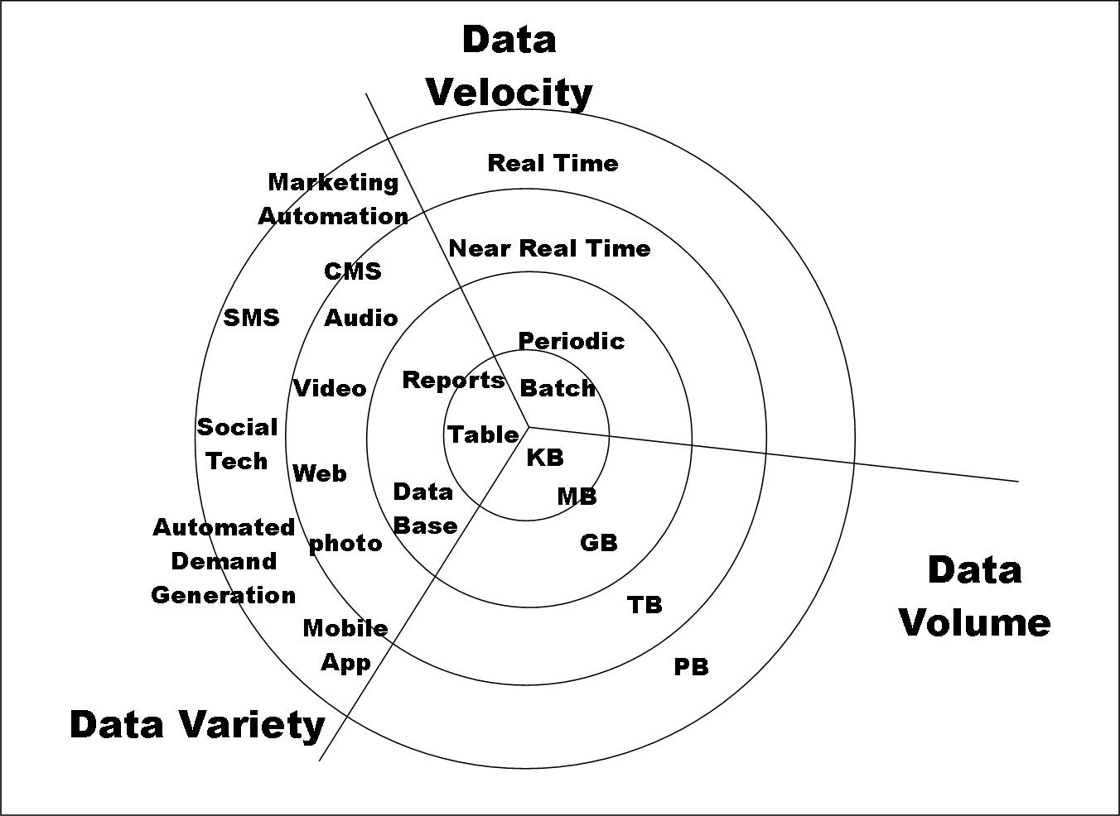
Need for HPC
The 3Vs of Big Data
Source: http://velvetchainsaw.com/2012/07/20/three-vs-of-big-data-as-applied-conferences/

Slide 4
Simple Geospatial Scenarios
Geocoding and reverse-geocoding
Geocoding: address to geographical coordinates
Reverse-geocoding: geographical coordinates to address
Example database: GeoNames (http://www.geonames.org/)
Navigation
Shortest/fastest path between origin and destination
Geoprocessing
GIS operations to manipulate spatial data, a typical example is the ArcGIS geoprocessing toolbox
Geospatial Data Integration
Integrating multiple geographical data layers for spatial analysis (e.g., multi-criteria analysis)

Slide 5
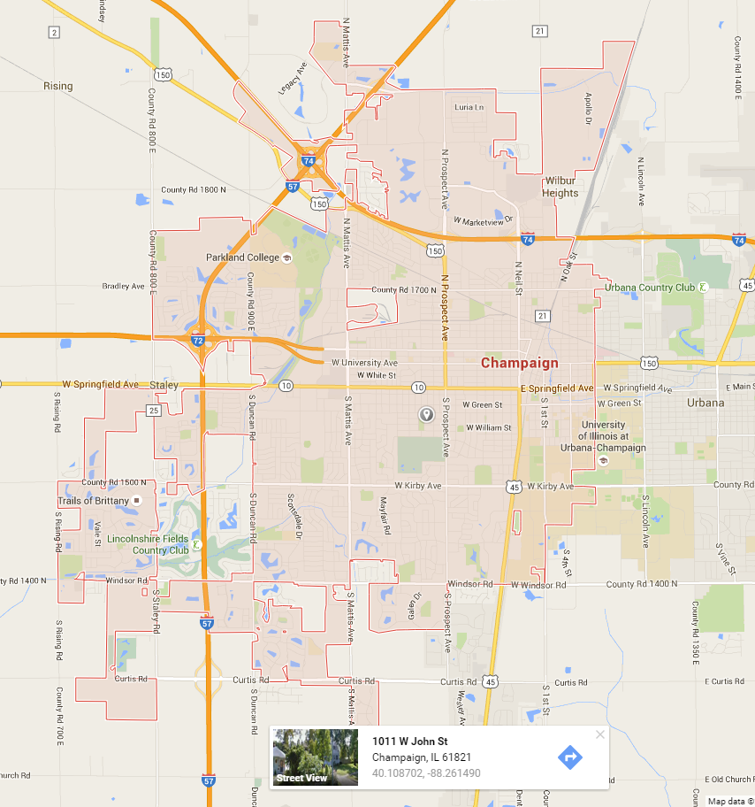
Simple Geospatial Scenarios
An example of geocoding using Google Maps API

Slide 6
Geospatial Big Data: New York Taxi Data
January 2013 Taxi Trips from FOIA (Freedom of Information Act) request from Chris Whong
(http://www.andresmh.com/nyctaxitrips/)
Trip:
medallion, hack_license, vendor_id, rate_code, store_and_fwd_flag, pickup_datetime, dropoff_datetime, passenger_count, trip_time_in_secs, trip_distance, pickup_longitude, pickup_latitude, dropoff_longitude, dropoff_latitude Fare:
medallion, hack_license, vendor_id, pickup_datetime, payment_type, fare_amount,surcharge, mta_tax, tip_amount, tolls_amount, total_amount

Slide 7
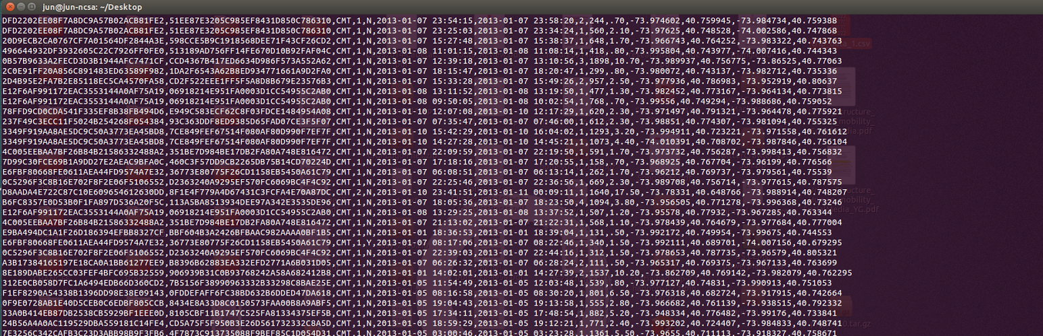
What does data look like?

Slide 8
Geospatial Big Data: New York Taxi Data
Each file contains chunks of data in csv format, ranging from ~1.5 to ~2.5 GB in size
Each file has about 14 million rows
What would you do?
If we want to know the location information for each pick up geographical coordinates?
If you want to determine the busiest road/street when taxi passes by
Where is the most dense pick-up/drop-off areas?
…

Slide 9
Computing Platforms
High Performance computing
Performance vs. scalability
Mainly realized via parallel computing
High-throughput computing
use of many computing resources over long periods of time to accomplish a computational task
Robustness and reliability of jobs over a long-time scale
Distributed computing
Grid computing
Cloud computing
Distributed databases

Slide 10
High Performance Computing
High Performance Computing (HPC) is computation at the cutting-edge of modern computing technology, often done on a supercomputer.
A supercomputer is in the class of machines that rank among the fastest in the world
Rule of thumb: a supercomputer could be defined to be at least 100 times as powerful as a ordinary PC
Computer performance is measured in FLoating point Operations Per Second (FLOPS or flop/s)
𝐹𝐿𝑂𝑃𝑆 = 𝑐𝑜𝑟𝑒𝑠 × 𝑐𝑙𝑜𝑐𝑘 rate ×Float point operation/C𝑦𝑐𝑙e
Most microprocessors today can do 4 float point operation per clock cycle. Therefore a 2.5-GHz processor has a theoretical performance of 10 billion FLOPs = 10 GFLOPs.
Notes:
What is high-performance computing? It uses cutting-edge computing techniques to solve data or computing intensve tasks. It’s different from the computational work you do everyday, such as get the sum of a number column in excel, calculate the regression line of dataset with 100 records. Some complex computing task may take weeks months or even cannot finish in your lifetime if you run them in a serial way in an ordinary PC.
HPComputing is often conducted in supercomputer, supercomputer is the class of . You can find such computer in the HPC center in our university, in Google, Amazon, IBM. All these super companies and top research institutes. Rule of thumb….
How do you judge the power of a computer? The most commonly used index is floating point Operations per second, or you can call Flops in short. Flops is calculated by multiplying number of cores, …., clock rate… the number of Flops can be down per Hz (Cycle).

Slide 11
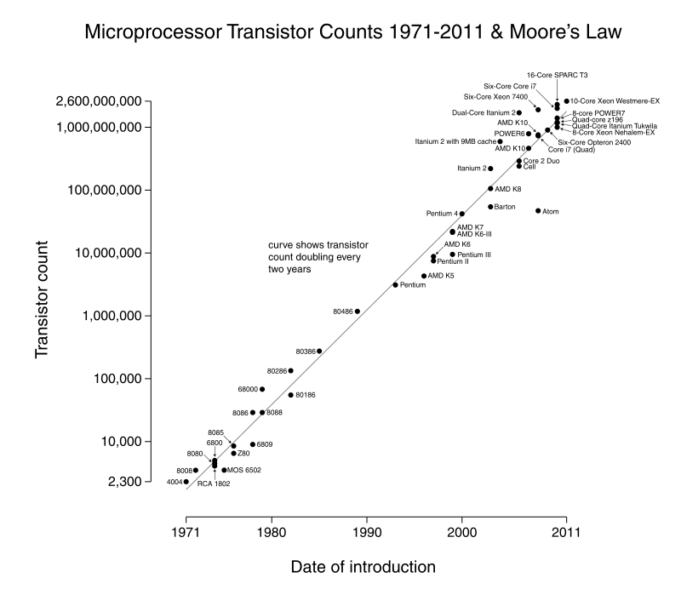
Development of supercomputers
Moore’s Law
over the history of computing hardware, the number of transistors in a dense integrated circuit doubles approximately every two years.
Source: https://en.wikipedia.org/wiki/Moore%27s_law

Slide 12
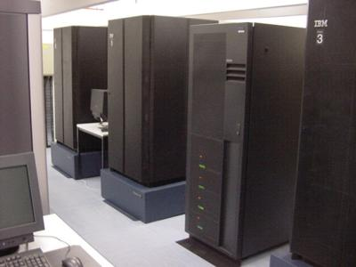
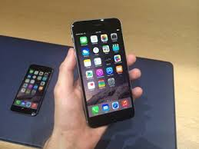
Development of supercomputers
Your cell phone today is equal to a supercomputer 15 years ago.
A8 CPU of Iphone 6/6 plus is around 112 GFLOPS, which can be ranked in Top 200 supercomputers in 2000
IBM SP power3 375 MHZ (15 years ago)
Iphone 6/6+ today

Slide 13
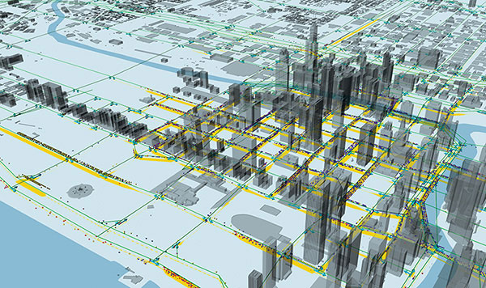

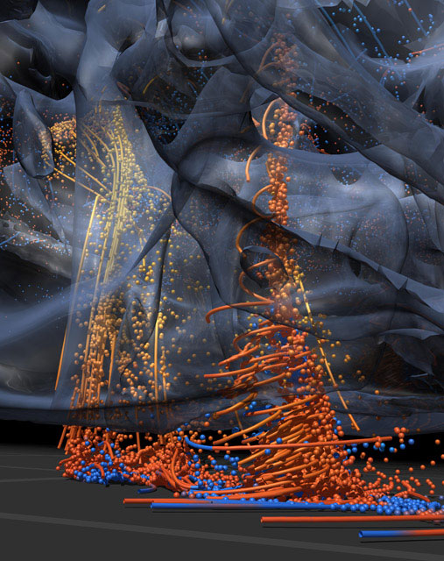
HPC Applications
Simulation of physical phenomena
Storm surge prediction
Black holes colliding
Molecular dynamics
Image source from: http://ncsa.illinois.edu

Slide 14
Parallel Computing
Parallel computing
Multiple processing units (workers) work simultaneously to process a workload
The processing units can be tightly or loosely coupled
In most cases, the processing units needs to communicate (sharing data) among each other for coordination.
Most supercomputers designed for parallel computing

Slide 15
Why Parallel
Natural phenomena operate in parallel fashion
Overcome the bottleneck of CPU speed and bandwidth
Solve large and complex problems (in many cases cannot be solved by serial computing)
Take advantage of modern parallel hardware
Save time/money
Limitations
Increased complexity of program (difficult debug)
Communication overhead among processes
Not all programs can be parallelized

Slide 16
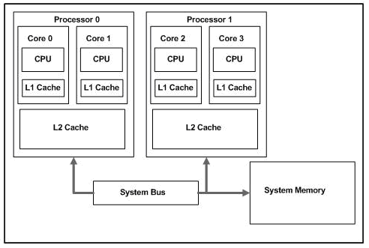
Parallel Computing Platform
Multiprocessor/multicore:
several processors/cores work on data stored in shared memory. (e.g., Intel Core i7 quad-core processor)
Shared Cache Example: A dual-core, dual-processor system

Slide 17
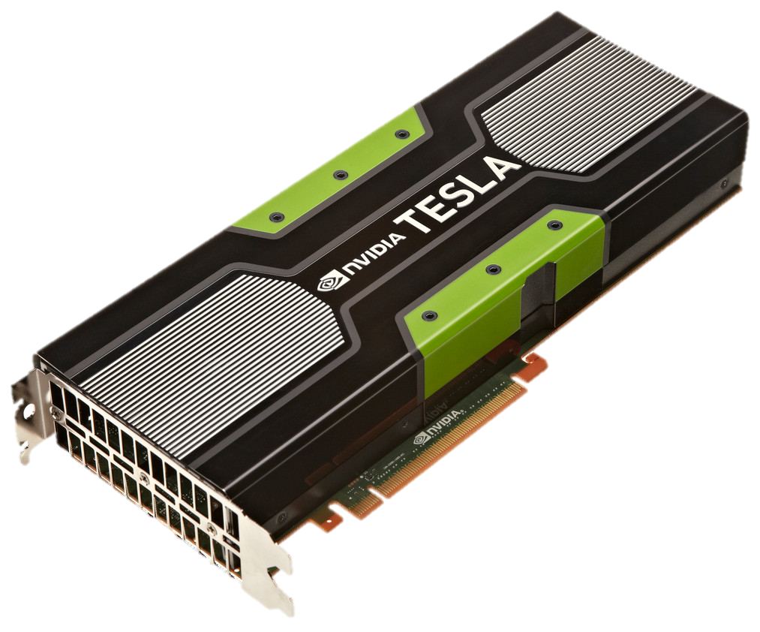
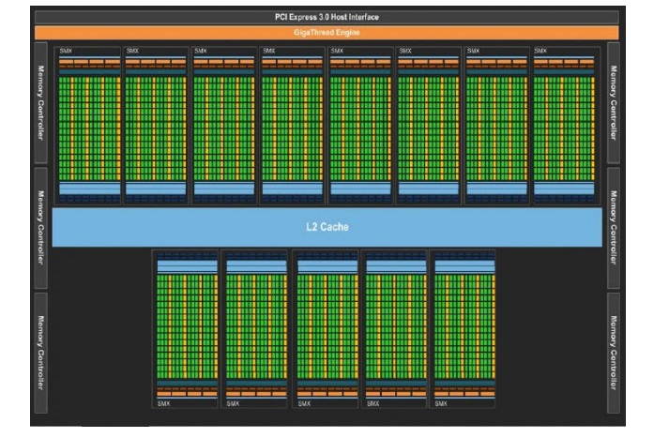
Parallel Computers
Co-processor:
a general-purpose processor supplement the functions of the primary processor (e.g. GPU)
Hybrid:
Cluster of multicore/multiprocessor nodes with GPUs
NVIDIA Tesla K20 GPU

Slide 18
Parallel Programming Models
There are different parallel programming models according to how data are shared and exchanged among processors.
Multi-Threading (shared memory)
Message passing (distributed memory)
Hybrid

Slide 19
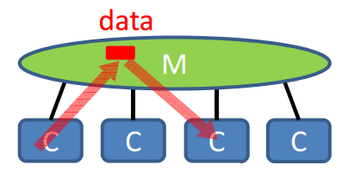
Multi-threading
Shared memory
All threads can access the global address space
Data sharing achieved via writing to/reading from the same memory location.
Advantage: no need to explicitly specify the data communication (simpler programming, easy translation from serial code)
Disadvantage: be careful for synchronization conflicts, only applies to Symmetric Multi-Processing (SMP) machines
Examples:
OpenMP (C, C++, Fortran)
Multiprocessing modules in Python

Slide 20
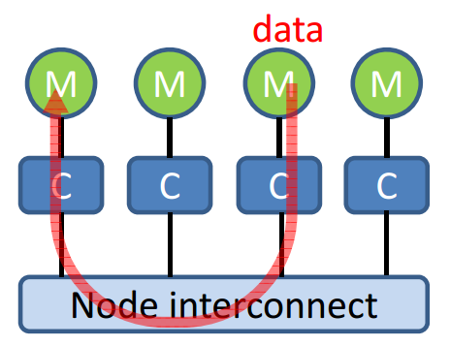
Message Passing
Distributed memory
A set of computing nodes use their own local memory during computation.
Data transfer requires specifying the sender, receiver and mode of transfer.
Advantage: High flexibility->higher performance
Disadvantage: Complex programming, not easy to translate from serial code. Communication overhead.
Example
Message Passing Interface (MPI) supported by most programming languages

Slide 21
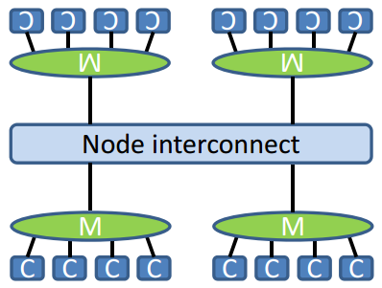
Hybrid model
Clusters of SMP (symmetric multi‐processing) nodes dominate nowadays
Two-Level Architecture:
1: Cores/processors share local memory
2: Nodes with distributed memory communicate through message passing
Combining different models, e.g. OpenMP and MPI

Slide 22
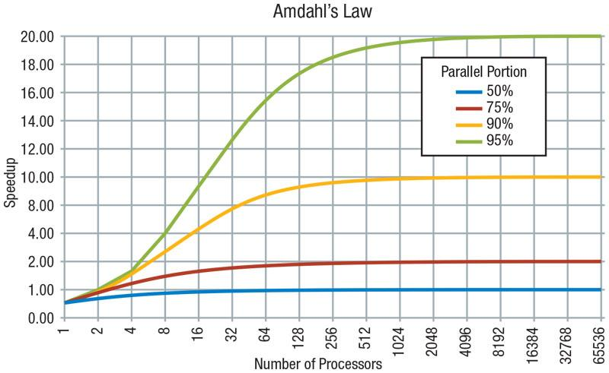
Scalability of Parallel Computing
T(n,p) is the time to solve a problem of size n using p processors
Speedup: S(n,p) = T(n,1)/T(n,p)
Efficiency: E(n,p) = S(n,p)/p
Scaled Efficiency: SE(n,p) = T(n,1)/T(pn,p)
Amdahl’s Law: Maximum speedup = 1/(1-Parallel portion)
Notes:
In CS, you may often heard the word scalability. Scalability refers to the suitability of a program for parallelization. Or in other words, whether the workload to solve a certain problem can be well allocated in multiple processors. There are a few indicators for scalability.
The first one is speedup. It refers to how many times faster your program can run by using more processors. For example, if your program takes (1) minute using 1 processor and takes half minute using 2 processor. Your program got a 2 times speedup.
(2) Efficiency measures whether the speedup is propositional to the number of processors that you use. When you are adding more processors run your program, if the program needs more cores to reach a same amount of speedup, it is not so efficient. E is a number between 0 and 1, the more closer it is to 1, the more efficient it is.
(3) The 3rd one is scaled efficiency, it measures whether your program can solve larger problem by using more processors. For example, assume that your program can process an 1GB RS image with 1 processor in 1 minute, and it can process a 8GB image with 8 processor still in 1 minute, your program has high scaled efficiency. If it takes much longer time than 1 min. to process the 8GB image with 8 processors, your program has lower scaled efficiency.

Slide 23
Data Parallelism
Data parallelism
The same task is run on different data in parallel
Example: convert all pixels in a raster to binary {1: developed, 0: other land cover}

Slide 24
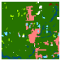








Data Parallelism
data
binary
binary
binary
binary
results
Can divide the raster into smaller blocks and run the tasks (i.e. binarize each block) in parallel
No dependencies between the tasks

Slide 25
Task Parallelism
Task parallelism
Different tasks are run on the same data concurrently
Example: summary indices of the same raster map, e.g. mean patch size, landscape connectivity, fractal dimension

Slide 26
Task Parallelism
data
mean patch size
conne-ctivity
fractal dim.
results 11.8 0.65 1.83
Several functions on the same data (especially when each function needs access to the full dataset)
No dependencies between the tasks

Slide 27
Hybrid Data-Task Parallelism
Structured
A parallel pipeline of tasks, each of which might be data parallel
Unstructured
Ad hoc combination of threads with no obvious top-level structure

Slide 28
Distributed Computing
Distributed data sources
Collaborative analysis
Parallel computing
Cloud computing

Slide 29
Node
Discrete unit of computer system, runs its own instance of OS (Ex. Laptop is one node)
Computing units → Cores: can process separate streams of instructions
Number of cores in a node = (number of processing chips) x (number of cores on a chip)
Note: Modern nodes contain processor chips sharing memory, disk

Slide 30
Cluster
Collection of machines (nodes) that function in some way as a single resource (e.g. Stampede)
Nodes of cluster are assigned by a “scheduler”
Job: Assignment of nodes for a certain user, certain amount of time
Notes:
Some clusters have multiple networks

Slide 31
Grid
Software stack facilitating shared resources across networks, institutions;
Deals with heterogeneous clusters
Most grids are cross-institutional groups of clusters, common software, common user authentication

Slide 32
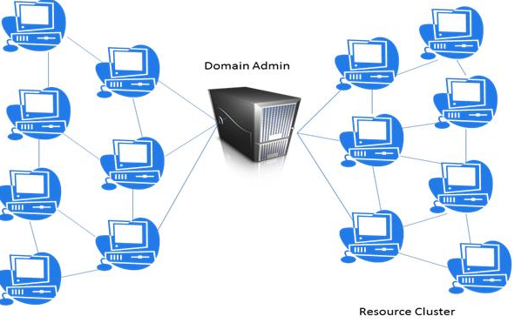
Grid Computing
Grid computing: combines the different computing resources derived from distributed locations to support a specific application
Grid: generates the connection between different computing resources
Image source: http://cloudservice24h.com/cloud-and-grid-computing-whats-different/

Slide 33
Major grids in the U.S.
OSG: Institutions organize themselves into virtual organizations (VOs) with similar computing interests. They all install OSG software
XSEDE: Similar to OSG, limits usage to dedicated high-performance network

Slide 34
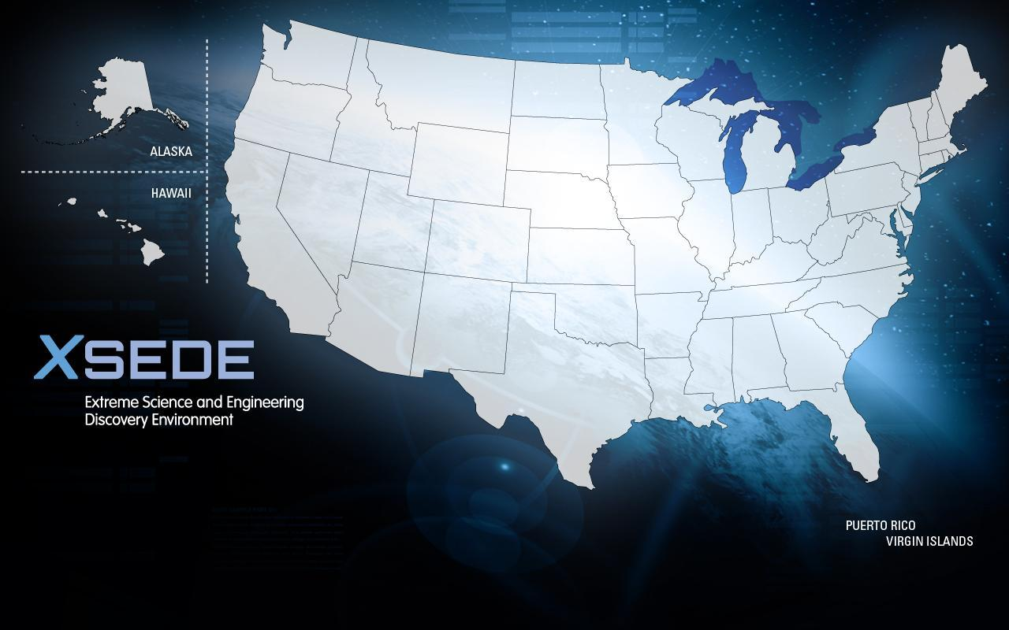
Campus Champion Institutions
Standard – 97
EPSCoR States – 56
Minority Serving Institutions – 12
EPSCoR States and Minority Serving Institutions – 9
Total Campus Champion Institutions – 174
Revised September 15, 2014

Slide 35
XSEDE
Extreme Science and Engineering Discovery Environment (XSEDE)
“most advanced, powerful, and robust collection of integrated advanced digital resources and services in the world”
Five-year, $121-million project is supported by the National Science Foundation
Originally TeraGrid until July 2011.
XSEDE is an extension and expansion of this original program.
16 supercomputers
Support short-term and long-term projects
No monetary cost to scientists
The goal is to give scientists and researchers the tools for creating scientific discoveries via high-performance computing technologies

Slide 36
XSEDE Resources
Four types:
Computing resources
Visualization resources
Storage resources
High-throughput resources

Slide 37
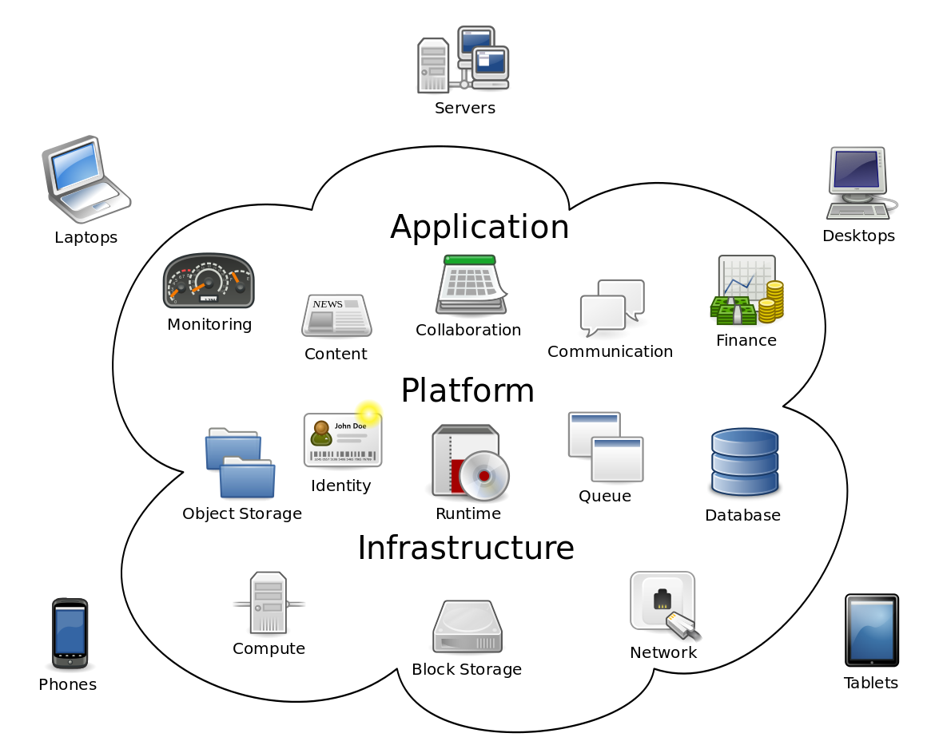
Cloud Computing
Cloud computing
Cloud computing is computing in which large groups of remote servers are networked to allow the centralized data storage, and online access to computer services or resources.
Notes:
The expression cloud is commonly used in science to describe a large agglomeration of objects that visually appear from a distance as a cloud
It describes any set of things whose details are not inspected further in a given context.

Slide 38
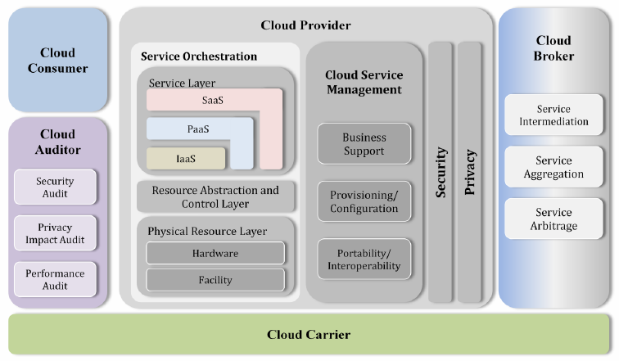
Architectural Model
Image source: http://www.softroots.com/public/library/cloud.cfm
Notes:
Talk about Service Orchestration
Talk about different roles in the model

Slide 39
Cloud Computing Services
IaaS: Infrastructure as a Service
Virtual machines, hardware and software
PaaS: Platform as a Service
Google API, web application services
SaaS: Software as a Service
Dropbox, Gmail
DaaS: Data as a Service
TopoLens, data.gov
Notes:
PaaS: a cloud computing model that delivers applications over the Internet
SaaS: software licensing and delivery model in which software is licensed on a subscription basis and is centrally hosted.

Slide 40
Essential Characteristics of Cloud Computing
On-demand self-service
Automatic service for customers
Broad network access
Across different systems (e.g., desktops, mobile phones)
Resource pooling
Consolidating different types of computing resources
Rapid elasticity
Quickly provisioning, allocating, releasing computing resources
Capabilities can be elastically provisioned and released, in some cases automatically, to scale rapidly outward and inward commensurate with demand.
Measured service
Supports “pay-as-you-go” service. Resource usage can be monitored, controlled, and reported, providing transparency for both the provider and consumer of the utilized service.
Automatically control and optimize resource use by leveraging a metering capability at some level of abstraction appropriate to the type of service.
Notes:
For example, for start-ups, amazon provide technical supports for helping security, networking, etc.

Slide 41
Cloud Consumer
SaaS
Directly use software or provide members with access
Document management, HR, billing, social networks
PaaS
Develop, test, deploy, manage applications
Databases, business intelligence, applications
IaaS
Access to virtual computers, storage, network infrastructure
Used for backup/recovery, storage, platform hosting

Slide 42
Cloud Provider
Acquires computing infrastructure, runs cloud software, delivers services through network.
SaaS
Deploys, configures, maintains software applications
Responsible for most of application control, management
PaaS
Manages infrastructure, runs cloud software
Supports application deployment, development through software development kits (SDKs)
IaaS
Acquires physical computing resources, runs cloud software (host OS, storage devices, network equipment, etc.)
Consumer takes over more fundamental computing resources like OS and network

Slide 43
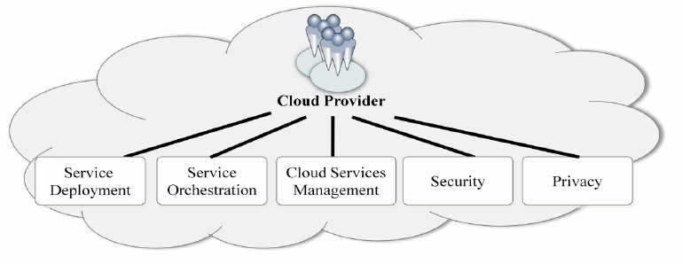

Slide 44
Cloud Auditor
Evaluate in terms of security controls, privacy impact, performance, etc.
Ensure confidentiality, integrity, and availability

Slide 45
Cloud Broker
An entity that manages the use, performance and delivery of cloud services
Able to negotiate relationships between cloud providers and cloud consumers
Provide three category of services
Service Intermediation
Service Aggregation
Service Arbitrage

Slide 46
Cloud Carrier
Provides connectivity and transport of cloud services between cloud consumers and cloud providers.

Slide 47
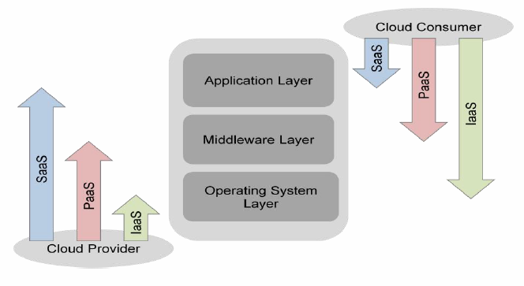

Slide 48
Geospatial Cloud Services
IaaS
Geospatial modeling
Allows for control over computing resources
PaaS
Best for parameter extraction
Examples: Vegetation index, sea surface temperature
SaaS
ArcGIS Online
Knowledge and decision support
Used by experts, managers, or public
DaaS
Earth Observation data access, storage and processing
Notes:
Parameter extraction requires complex geospatial processes (reformatting, reprojecting, etc.)

Slide 49
Types of clouds
Public Cloud
Private Cloud
Community Cloud
Hybrid Cloud
Notes:
F

Slide 50
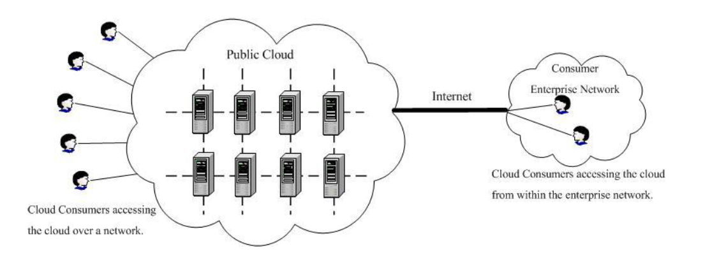
Public Cloud
The cloud infrastructure and computing resources are made available to the general public over the Internet.
Notes:
F

Slide 51
Public Cloud
Amazon Elastic Compute Cloud (EC2)
http://aws.amazon.com
IBM’s Blue Cloud
Sun Cloud
Google AppEngine
Windows Azure Services
Notes:
F

Slide 52
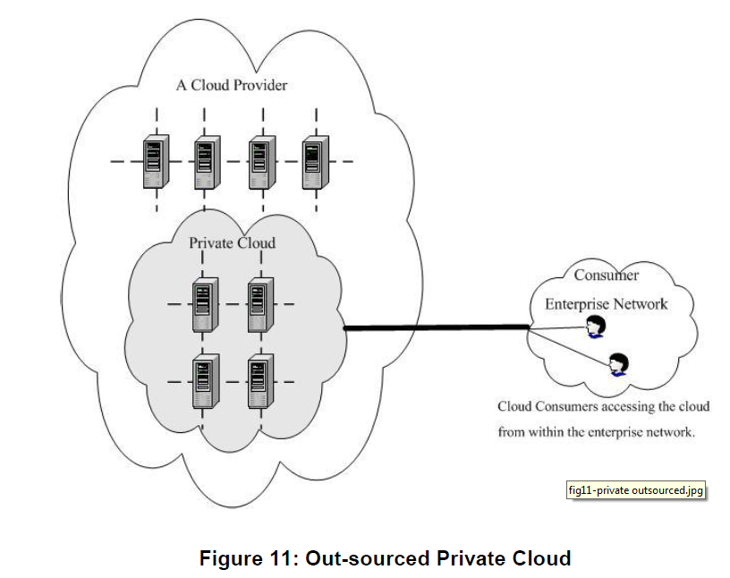
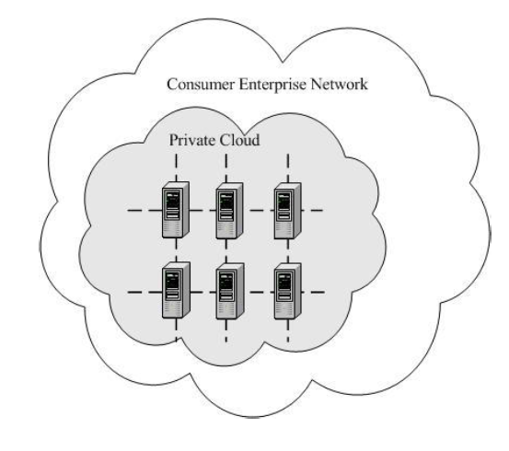
Private cloud
For a single Cloud Consumer’s organization
Exclusive access given to usage of the infrastructure and computational resources.
Notes:
F

Slide 53
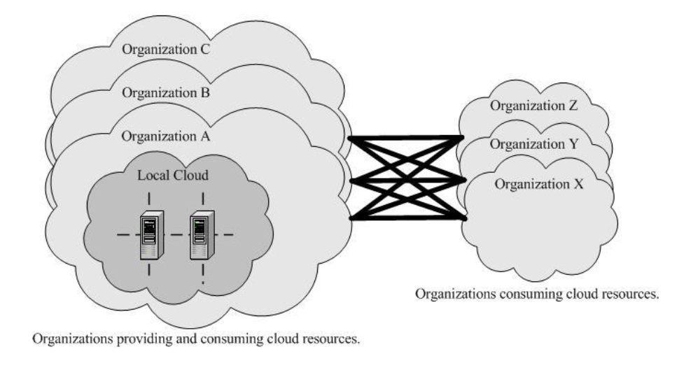
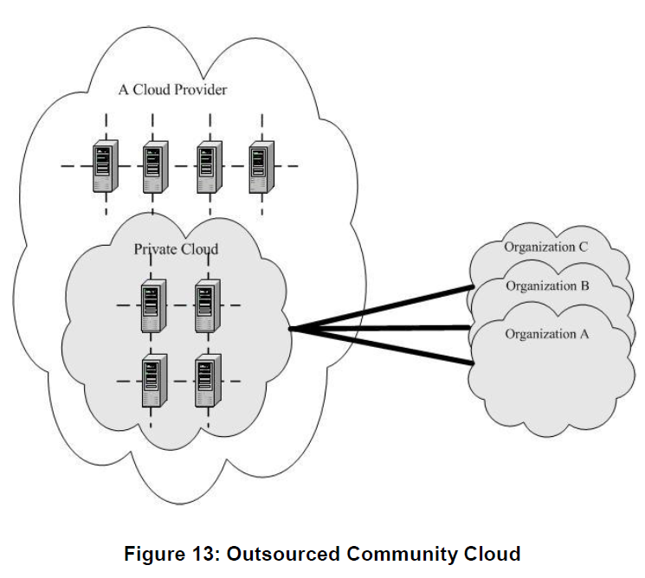
Community Cloud
A group of Cloud Consumers which have shared concerns (e.g. mission objectives, security, privacy and compliance policy)
Notes:
S

Slide 54
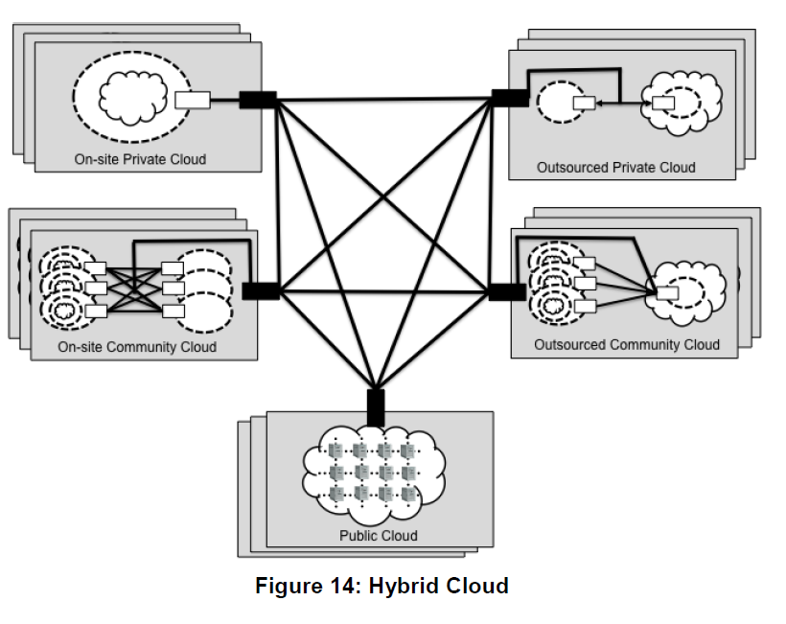
Hybrid Cloud
A composition of two or more clouds
These clouds are bound together by standardized or proprietary technology that enables data and application portability.
Notes:
S

Slide 55
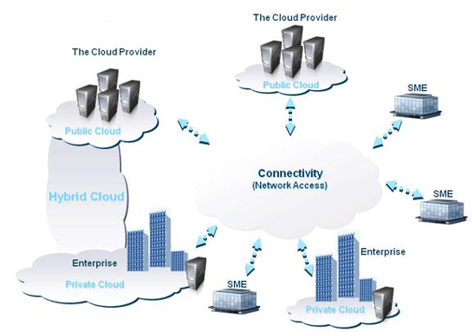
Notes:
S

Slide 56


Slide 57
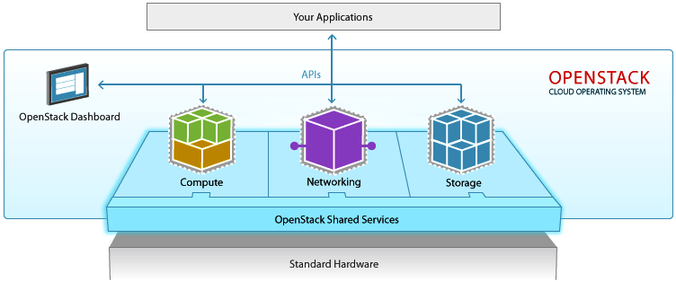
What is OpenStack?
A cloud operating system that controls large pools of computing, storage, and networking resources.
image source: openstack.org

Slide 58
Benefits of OpenStack
Flexibility – immediately create new virtual servers with user specified computing, storage, networking, and OS requirements
Manageability – monitor existing servers, reboot or suspend existing servers, change storage, create complete system images as backups
Sharing and Collaboration – create a duplicate server for development or to isolate groups, share a system image with pre-installed software collaborators
Instance – a virtual server running in a cloud environment
Snapshot – a backup of an instance or storage block
Image – a bootable snapshot that contains an operating system

Slide 59
OpenStack Components
Nova – cloud computing controller which manages computing resources and instances
Glance – operating system image service
Swift – object storage for archiving and sharing large amounts of data
Keystone – identity service and access control of OpenStack services
Neutron – networking and IP address management
Cinder – block storage management for managing file system storage
Heat – provides orchestration where multiple composite cloud implementations

Slide 60
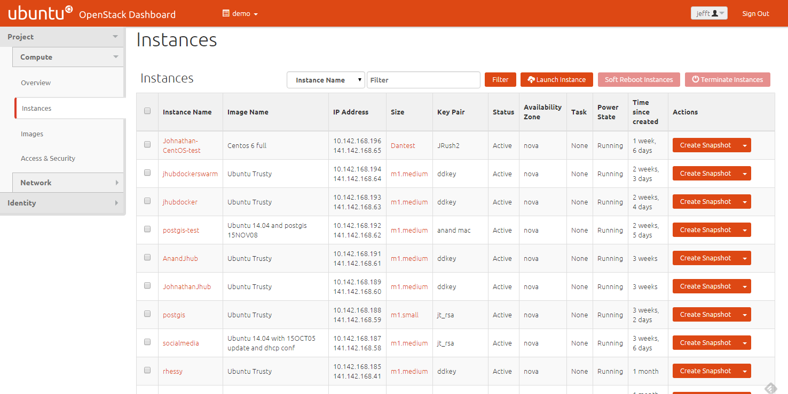
Horizon the OpenStack Dashboard

Slide 61
OpenStack on ROGER
Currently using 4 nodes each with 20-cores and 128GB of memory
Shared access to the 4.5PB of storage on ROGER
35 active instances
web servers
geoserver and database services
gateway apps
development

Slide 62
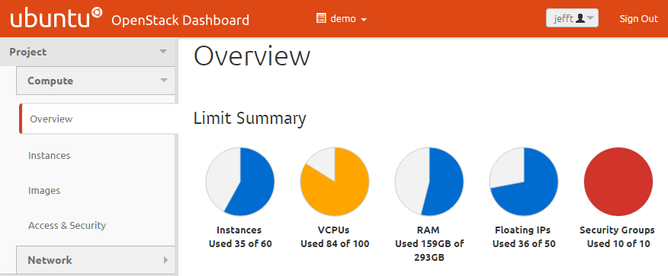
Current Utilization

Slide 63
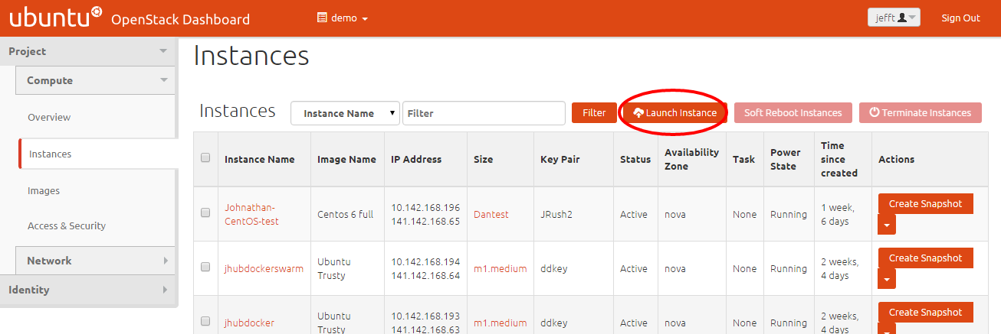
Create New Instance

Slide 64
Available Machine Sizes
Flavor | CPUs | Memory | Disk
r1.micro | 1 | 512 MB | 5 GB
m1.small | 1 | 2 GB | 20 GB
m1.medium | 2 | 4 GB | 40 GB
m1.large | 4 | 8 GB | 80 GB
JR.large | 10 | 16 GB | 100 GB

Slide 65
Available Images
Base Operating Systems
Centos 6
Centos 7
Fedora 20
Ubuntu Trusty
Microsoft Windows WS2012R2
Custom Environments
PostgreSQL/PostGIS 9.3
Jupyter Hub
GitHub Enterprise 2.2.5
Server Snapshots

Slide 66
Distributed Computing using Hadoop
What is Hadoop
Distributed file system + replicating data in multiple nodes.
Easy-to-use MapReduce interface.
Scalable.
Parallel execution of mappers/reducers.
Fault tolerant.
When to use Hadoop
Data is too big to fit into memory.
Tasks can be decomposed as batch-based processing.
The problem can be modeled by MapReduce computing paradigm.
Scalability is the major issue not interactivity.

Slide 67
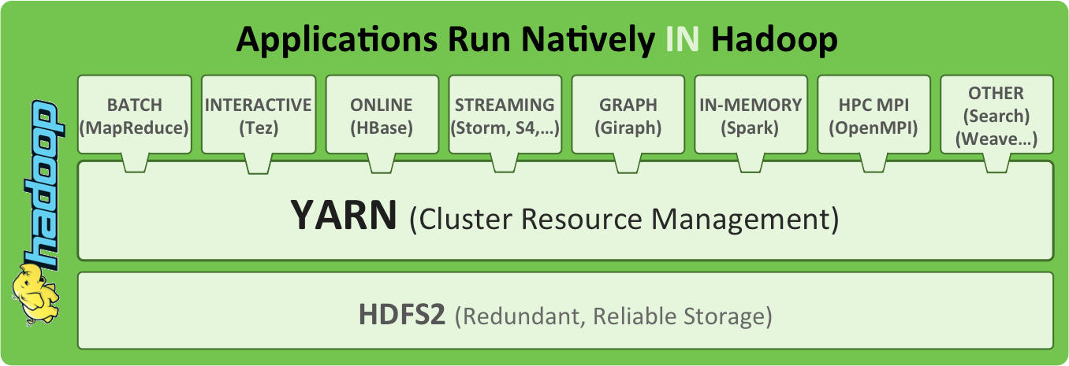
Hadoop Architecture
Source: http://radar.oreilly.com/2014/01/an-introduction-to-hadoop-2-0-understanding-the-new-data-operating-system.html
Notes:
Yahoo developed HDFS to compete with GFS (Google). Google developed MapReduce for their own system.
Yarn for resource management. Queue system.
Hbase – big table, column based database. OS version. SQL-like.
Hive for Hbase
Pig for raw data like loaded CSVs

Slide 68
Distributed Computing using Spark
What is Spark
An open-source cluster computing framework originally developed in the AMPLab at UC Berkeley
The fundamental programming abstraction is Resilient Distributed Datasets (RDD), which is a logical collection of data partitioned across machines.
Run programs up to 100x faster than Hadoop MapReduce in memory, or 10x faster on disk.
Ease of Use
Write applications quickly in Java, Scala, Python, R.
Runs Everywhere
Spark runs on Hadoop, Mesos, standalone, or in the cloud. It can access diverse data sources including HDFS, Cassandra, HBase, and S3.
When to use Spark
When the operations involves iterations, especially machine learning and data mining algorithms
Repeatable/multiple queries on the same large dataset

Slide 69
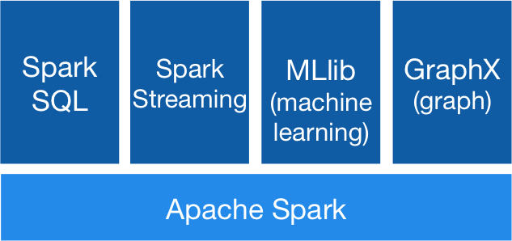
Spark
Source: http://spark.apache.org/
Notes:
Yahoo developed HDFS to compete with GFS (Google). Google developed MapReduce for their own system.
Yarn for resource management. Queue system.
Hbase – big table, column based database. OS version. SQL-like.
Hive for Hbase
Pig for raw data like loaded CSVs

Slide 70
Useful resources and links
XSEDE training
https://portal.xsede.org/training/overview
https://www.xsede.org/web/xup/online-training
Free Azure training March 18th, 2016
http://research.microsoft.com/en-US/events/azure4researchtraining-illinois2016/default.aspx
Date: March 18, 2016 Time: 9:00 A.M. to 5:00 P.M. (check-in begins at 8:30 A.M.) Location: University of Illinois Building/room: 2405 Siebel Center Address: 201 N Goodwin Ave, Urbana, Illinois 61807-2302
Lunch will be provided

Slide 71
cyberinfrastructure
CyberGIS is Geographic Information Science and Systems based on advanced cyberinfrastructure.
Cyberinfrastructure includes:
(high performance) computing systems
data storage systems
advanced instruments
data repositories
visualization environments
people
linked by high speed networks
Notes:
CyberGIS is Geographic information science and systems based on advanced cyberinfrastructure

Slide 72
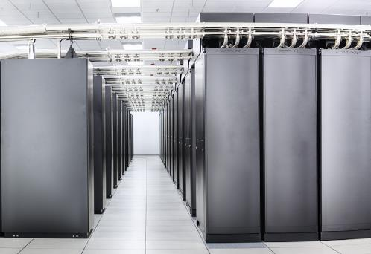
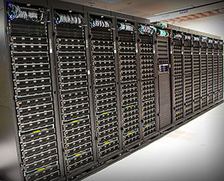
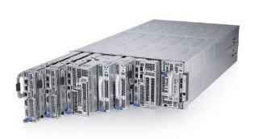
CyberInfrastructure Resources
NSF Blue Waters @ UofI
NSF XSEDE: SDSC Comet
UofI Campus Cluster
13,300 TFlop/s
2,000 TFlop/s
Notes:
Examples of the kind of computational/hardware resources that our group has made use of and can be targeted by the GISolve Open Service API / Middleware.

Slide 73
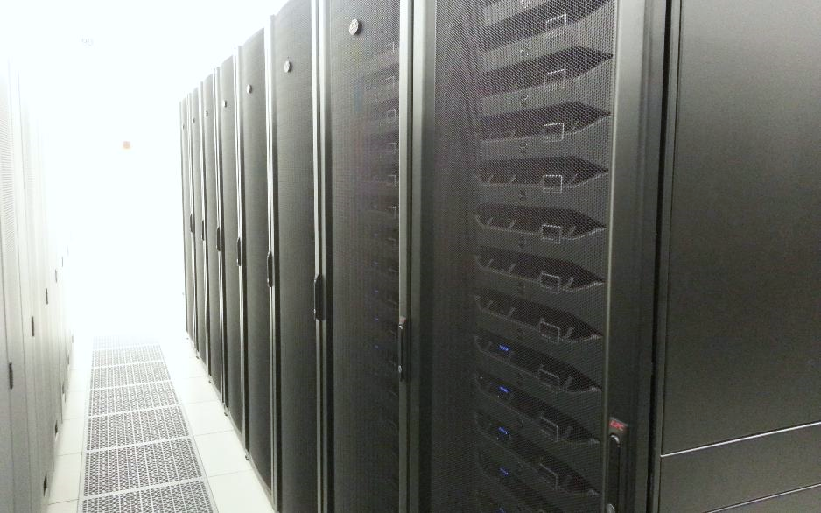
CyberGIS ROGER
CyberGIS ROGER
Resourcing Open Geospatial Education and Research
After Roger Tomlinson
goo.gl/8MpYC9
~60 TFlop/s
Notes:
Roger Tomlinson has been called the “Father of GIS” thanks to his leadership of the Canada Geographic Information System, the first computerized GIS.
The Tflops number for ROGER is theoretical, it has not been benchmarked yet. It is undergoing testing now, and should be fully open for use before fall semester. For more information, contact Johnathan (jfr@Illinois)

Slide 74
Why ROGER?
Both a research project and a research resource
Configured to best support geospatial data, with emphases on local memory and shared storage size and speed
Supports multiple paradigms: traditional batch HPC, Hadoop, and Cloud (OpenStack).
Integrate the three paradigms and leverage their strengths
Inform the design of future geospatial supercomputers

Slide 75
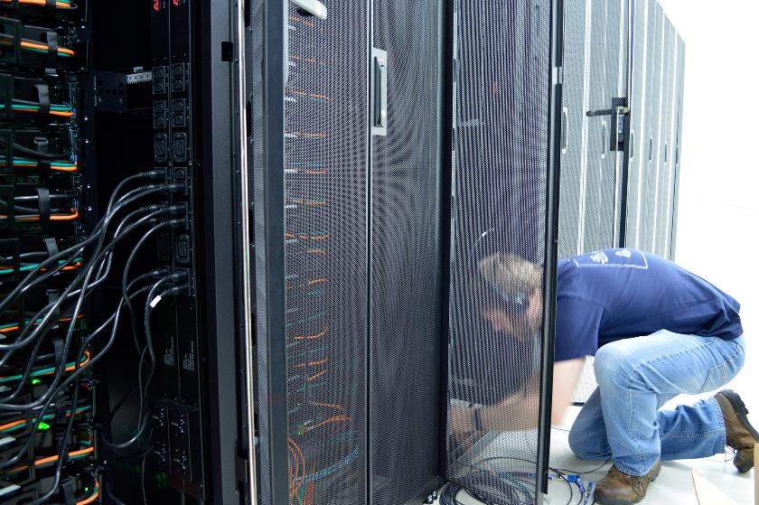
ROGER: Overview
Provides the CyberGIS Center with HPC, Hadoop and OpenStack functionality all on one system
Managed by Systems Group
With support from our storage, network, security and services groups

Slide 76
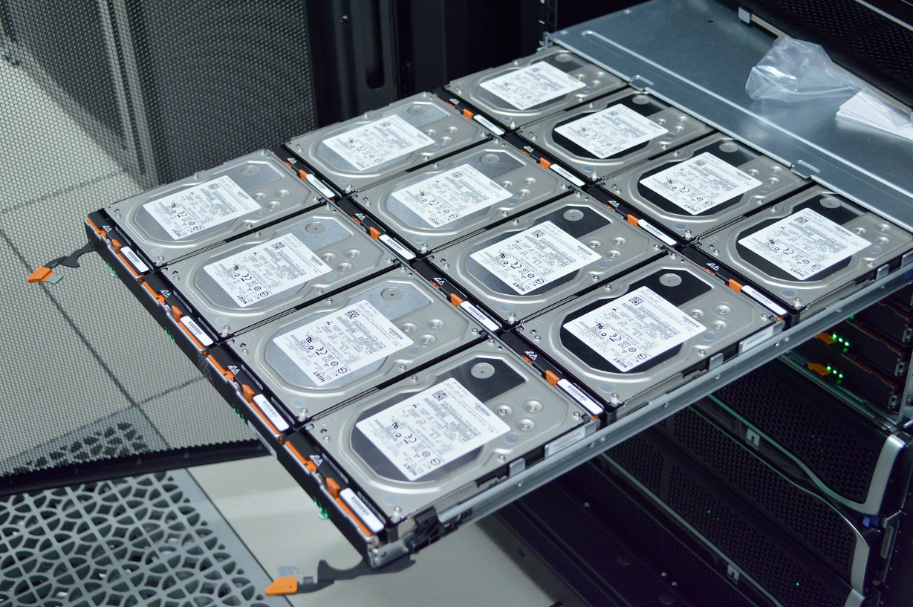
ROGER: File system
IBM General Parallel File System (GPFS)
Parallel file system means all of the nodes get fast access to hard drive storage.

Slide 77
ROGER for this class
ROGER accounts for every student in this class
Interact with various components in ROGER
Job submission
Handling and processing massive data with Hadoop, Spark, R, and Python, etc.
Getting to know OpenStack
Working with Geospatial libraries

Slide 78



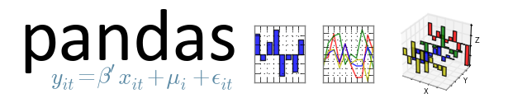

Discussion on ROGER Resources

Slide 79
Register to ROGER
Provide your netID to the Google Doc:
https://docs.google.com/spreadsheets/d/1zWkT6RnUiwvcYzEBIKCNHUIZFx0G-dJLBb_mml7r7Ys/edit?usp=sharing
2. After the lecture, the above document will not be accessible (for privacy concerns)

Slide 80
Reference
Liu, F., Tong, J., Mao, J., Bohn, R., Messina, J., Badger, L., & Leaf, D. (2011). NIST cloud computing reference architecture. NIST special publication, 500, 292.
Yang, C., Raskin, R., Goodchild, M., & Gahegan, M. (2010). Geospatial cyberinfrastructure: past, present and future. Computers, Environment and Urban Systems, 34(4), 264-277.
Some slides were derived from CyberGIS Fellows:
Jie Tian Clark University
Wenwen Li, Arizona State University
Yi Qiang and Nina Lam, Louisiana State University

